Slide 1
Data Science
An Introduction
Notes:
The 21st century, by many is the known as the information age.
Compared to the previous century, we as a human civilization are becoming heavily dependent on information sources for our day to day needs, whether it is for buying a new phone, looking for an apartment, searching for a direction to a place, the digital world plays a vital role in delivering this information from the vast knowledge base, that is the world wide web or as we simply know it - as the internet.
With the advent of new and sophisticated electronic devices that are tightly coupled with information, this is the time for Internet of Things where devices will not just wake us up, but they can make breakfast for us by predicting our mood and also automated cars will drive us to office on time by calculating the best travel route.
These new technologies are not just dependent on data but also the correctness of the information has never been as critical.
This is where data science using algorithms and machine learning techniques is able to convert raw data into analytical information that can be used to make right decisions.

Slide 2
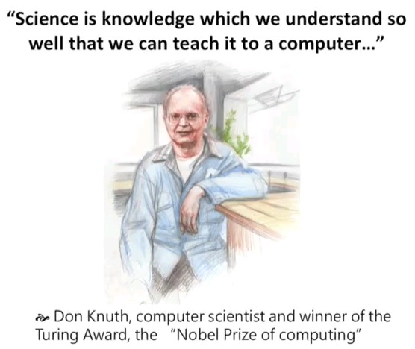

Slide 3
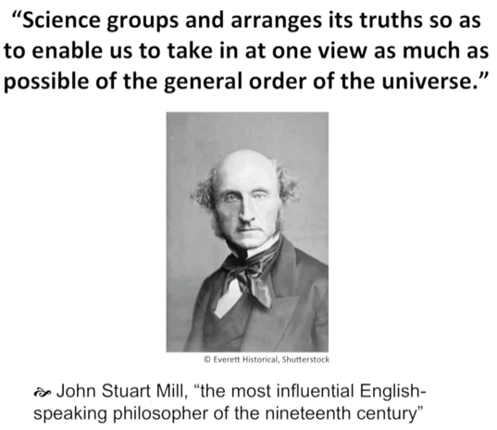

Slide 4
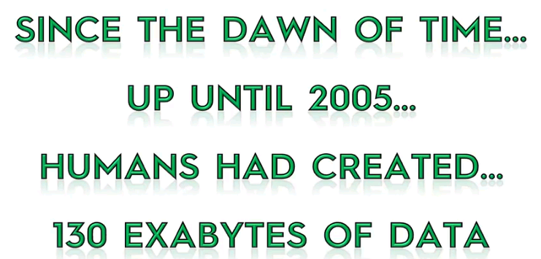
data science understanding the FOUR v’s of data science volume, velocity, variety, VERACITY
Notes:
Now what does this 130 exabyte of data correspond to.. And how can we relate to something in the real world..

Slide 5

Lets start with 1 byte
Notes:
A single character of English alphabet corresponds to 1 byte.

Slide 6
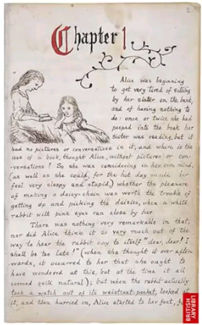
ZOOM OUT A 1000 TIMES AND WE HAVE 1 KiloByte
Notes:
A page in a book with around 500 to 1000 characters..

Slide 7

Zoom out another 1000 times and we have 1 Megabyte
Notes:
An average book of 500 to 100 pages stored on a disk will consume around 1 MB of data

Slide 8
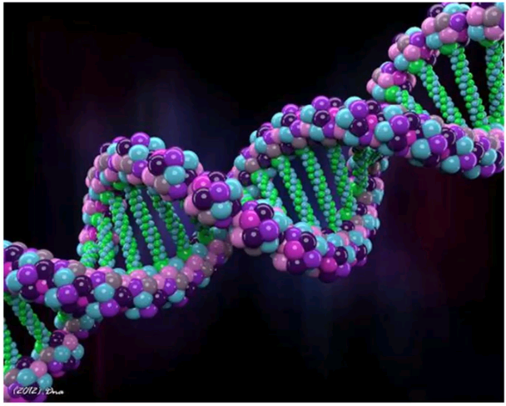
ZOOM OUT A 1000 TIMES AND WE HAVE 1 GigaByte
Notes:
All the information recorded in the genome or DNA of an individual that includes the information about the cells, the neurons, characteristics of the person and the entire genetic makeup with hair, skin, colour, organs, blood type, chemical balance

Slide 9
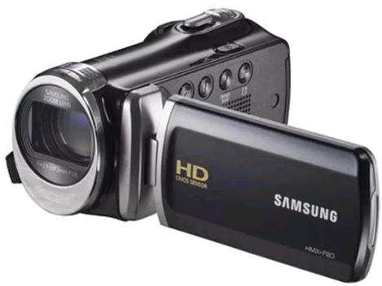
ZOOM OUT another 1000 TIMES AND WE HAVE 1 teraByte
Notes:
Take a HD cam and follow a person for every single day of their life and the data collected is in the range of a tera byte

Slide 10
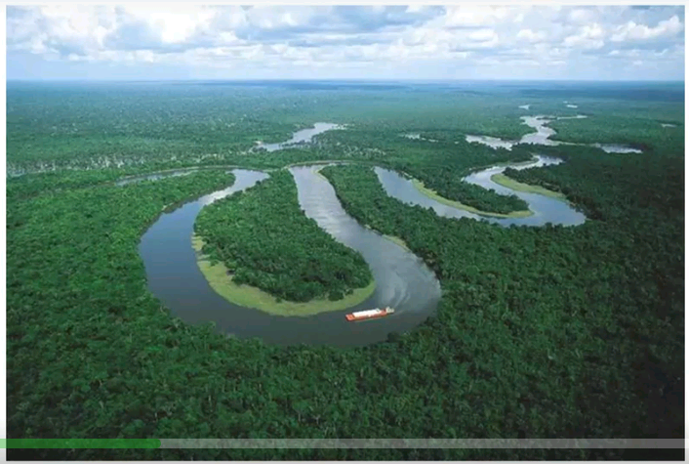
ZOOM OUT A 1000 TIMES AND WE HAVE 1 petaByte
Notes:
The amazon rain forest makes up about 1.4 billion acres of trees.. If we take all the trees, cut them up and make papers out of them. And fill all of this papers collected with letters, then that would amount to 1 Peta Byte of data.

Slide 11
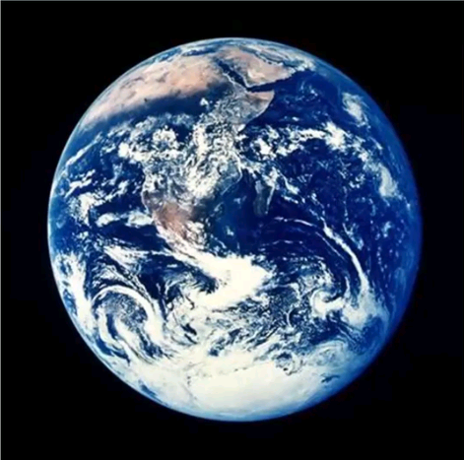
Again lets ZOOM OUT a 1000 TIMES AND WE get an exaByte
Notes:
Take all the data in the world and we get an exabyte

Slide 12
Notes:
Going back to the start, until 2005 humans have created 130 Exabyte of data, that includes, all information humans have documented since his arrival in written, spoken, folklore, sports, all recorded history . I.e.. Any kind of data ever produced by humans.
By 2010 this number had grown to 1200 exabytes of data.
By 2015, this number had reached a staggering 8000 exabytes of data.
And by 2020, it is expected to reach around 40,000 exabytes.
Data in the world is growing very exponentially.
And as we understand as the Volume of the data grows so does the need to understand and analyze the data.
Consider the early 2000’s when smart phones were yet to make their presence. Our daily source of news was the news paper or the television. The occasional peep at the internet for news and views in the form of blogs were present. But with advent of smart phones and the information bombardment, we are comtinuously on the turn of every minute consuming news , social media and other information.
Due to this phenomina, organizations are striving to deliver information to the masses that are analyed and as per the needs of the audience.

Slide 13
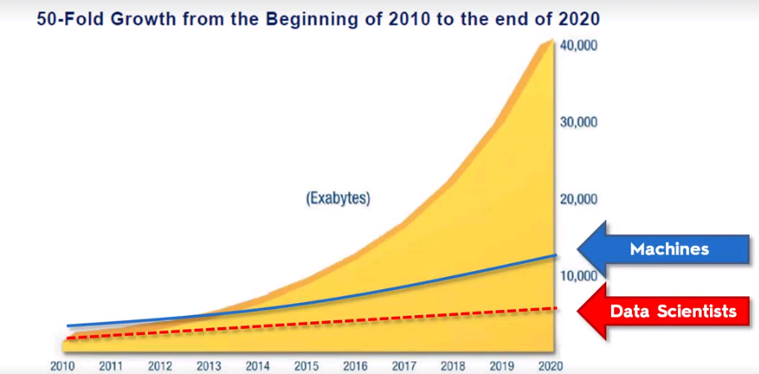
Opportunities in data science
Source: IDC’s digital universe study sponsored by EMC, December 2012
Notes:
Source: IDC’s digital universe study sponsored by EMC, December 2012.
This shows how lucrative the profession of data science is and will be in the near future as you can see by 2020, only 10% of the worlds data scientists and machine needs can be met to handle the huge data volumes and to analyze all this information.

Slide 14
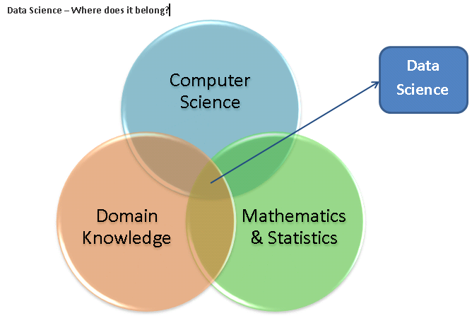
Data science domains

Slide 15
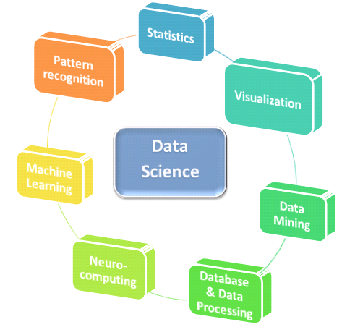
Areas of Data science
Notes:
Neuro computing, Machine Learning and pattern recognition cater to one single goal and that is teaching computers how to analyze without being explicitly programmed.

Slide 16
Additionally a data scientist must possess below skills
Communication – Not all insights are in data, some can only be picked up while talking to analysts, stakeholders of respective systems.
Presentation – Should be able to communicate all the business insights gathered in a very presentable manner to the stakeholders
Domain Knowledge – Having knowledge of the specific industry weather it is finance or healthcare or oil industry is an added advantage
Real Life practice – Thumb rule – 90% practice and 10% Perform
Programing – Ability to talk to a machine
Creativity – Use creativity to guide you to get more insights into data and present it more effectively.

